Slide 1
Peepers by eve bunting
Rich Vocabulary Practice

Slide 2
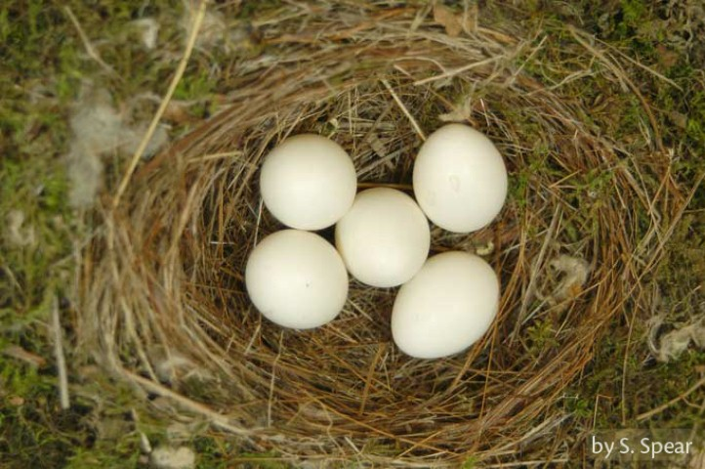
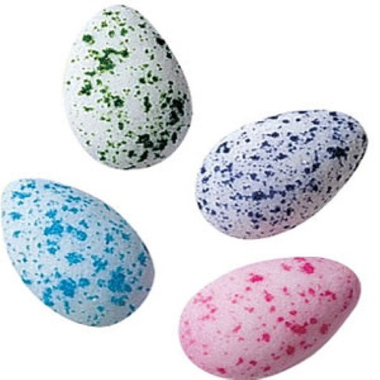
speckled
Speckled: to mark with small spots.
My shoes were speckled with dots of paint.
Which picture shows eggs that are speckled? How would you describe how speckled looks if you could not show a picture?
A. B.

Slide 3
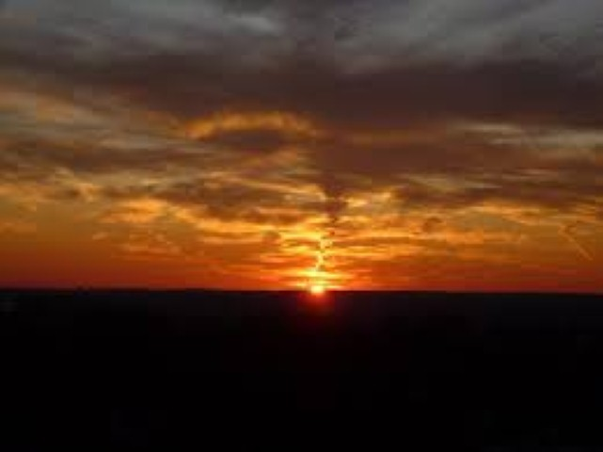
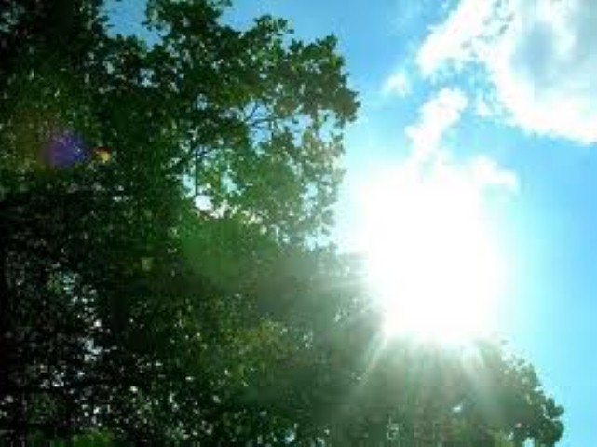
fading
Fading: to disappear slowly
The leaves are fading now. They drop one by one.
Which picture shows the sun fading? Describe the fading sun using sensory words (colors, light, shadows). How does the light around you change when the sun is fading?
A. B.

Slide 4
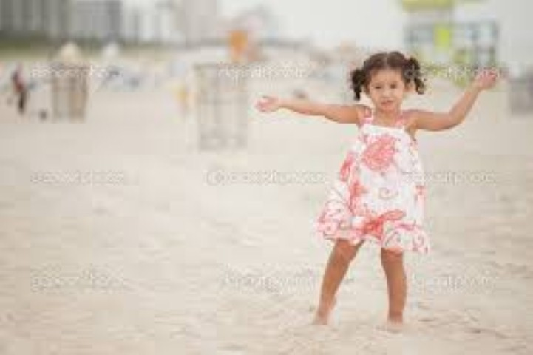
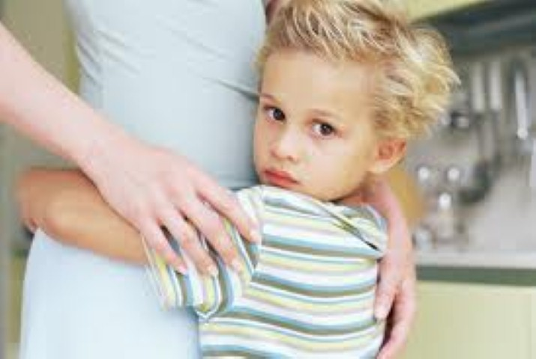
cling
Cling: To hold on to like glue; to hold tightly.
A few leaves cling to the top branches. Finally, the leaves all blow away with the wind.
Which picture shows the word cling? When might you want to cling to something? What feelings or events make you want to cling?
A. B.

